Slide 1

A parallel hill climbing algorithm for pushing dependent data in clients-providers-servers systems
Universidad Nacional Autónoma de México
Francisco Javier Ovalle Martínez
Julio Solano Gonzalez
Ivan Stojmenovic
Ivan@site.uottawa.ca
www.site.uottawa.ca/~ivan

Slide 2

Data broadcast
-Server (satellite) broadcasts data files from providers in round-robin manner.
Clients may access two files in any order (AND), one out of two files (OR), and second file only after accessing first (IMPLY).
Order the files to minimize the access time of the clients given probabilities for desiring file pairs in AND-OR-IMPLY-AOI cases.
Bar-Noy, Naor and Schieber MOBICOM 2000

Slide 3
Probabilities
F={F0, F1, ..., Fn-1}: n files of equal size.
AND, probability to access Fi and Fj is a(i,j).
OR, probability to access Fi or Fj is b(i,j).
IMPLY, probability to access Fi after Fj is c(i,j).
AOI, probabilities for AND(α), OR(β), IMPLY(γ) user, α+β+γ=1
Probability to access Fi-Fj pair in one of four given cases is x(i,j).

Slide 4
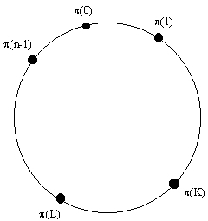
File permutation and expected access time
π = (π(0), π(1), ..., π(n-1)).
d(i,j) shorter cycle distance Fi - Fj
dd(i,j) directed distance Fi – Fj
A(π), B(π), C(π), E(π), X(π)
=expected access times for
AND-OR-IMPLY-AOI-any

Slide 5
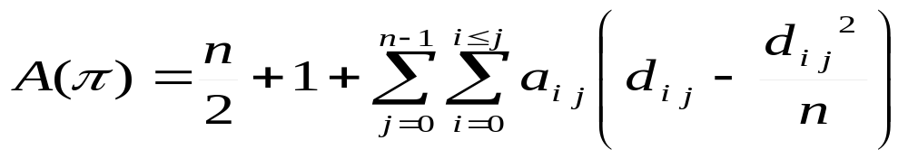
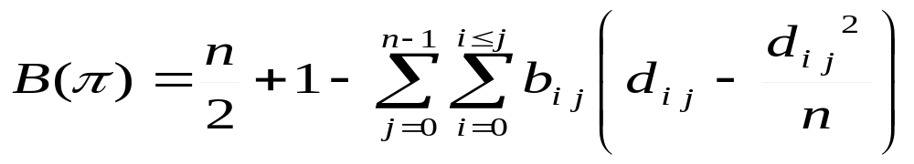
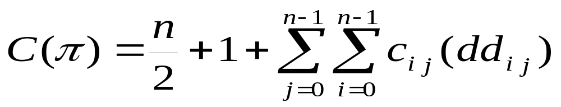
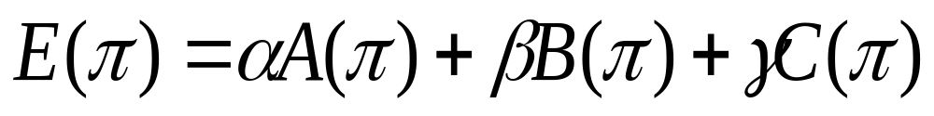
Expected access (waiting) times

Slide 6
Problem statement
Input:
  n, a(i,j) / b(i,j) / c(i,j), AND/OR/IMPLY/AOI
Compute distances for candidate π :
σ = π⁻¹, σ(π(i)) = i
d(i,j)=min{ ((σ(i) - σ(j)) mod n), ((σ(j) - σ(i)) mod n)}
dd(i,j)= ((σ(j) - σ(i)) mod n)
Output:
Permutation π that minimizes X(π), X = A / B / C / E

Slide 7
Existing solution to minimize X(π)
Bar-Noy, Naor and Schieber MOBICOM 2000
Generate m random permutations, evaluate each in O(n²) time, choose the best one.
2. Test m deterministically chosen permutations, choose the best one, not better than with random selection

Slide 8
Hill climbing solution
Generate initial permutation π at random
Repeat
  swap two bits of π at random to obtain π’
  If π’ is better then π=π’
Until no improvement in max consecutive attempts
Parallel hill climbing:
Call hill climbing t times, choose best overall π

Slide 9
Why is (parallel) hill climbing faster
Calculation of X(neighbor(π) from X(π) can be done in O(n) time instead of O(n²) time in random permutation solution
Expected speed up is n times
Impact on quality of solution to be determined

Slide 10
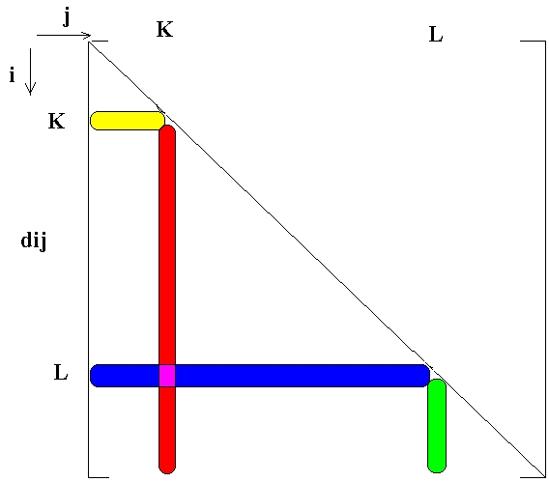
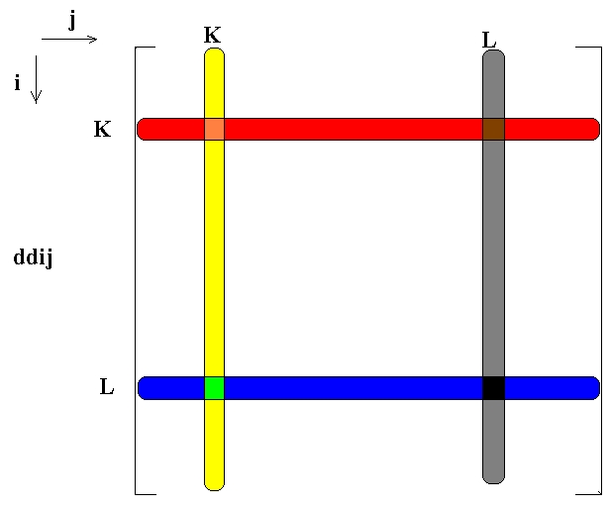
Calculating X(neighbor(π)) from X(π)

Slide 11
Experiments – generating probabilities
Groups of files, e.g. sports, science, news
High probability for two files from the same group
Low probability for two files from different groups
t permutations of size n, t=15-75, n=5, 25
Apply hill climbing on each, count total number of evaluated permutations
Generate the same number of random permutations for comparison
Experiment 2: run both algorithm for the same time

Slide 12
Experimental results
hill climbing algorithm is 2n-3n times faster that random permutations method, both in terms of
  time needed to evaluate the same number of permutations, and
  time needed to provide a high quality solution.
Random permutation method produces high quality permutations, but requires extremely significant time to do so
MATLAB used for experiments

Slide 13
Conclusions
Parallel hill climbing is superior to random permutation method in running time
Evolutionary computation, simulated annealing, tabu search, neural networks ... are not expected to furher improve significantly
Three or more files dependance can be studied
Some files could be repeated in cycle, providers with different file supplies, permutations with repetitions

